Slide 1
CAUSES OF THE GREAT DEPRESSION
Unequal Distribution of Wealth
High Tariffs and War Debts
Overproduction in Industry and Agriculture
Farm crisis
Federal Reserve Monetary Policy and the actions of the banks
Stock Market Crash and Financial Panic

Slide 2
Historians disagree as to the causes of the Great Depression. Most scholars would include:
HIGH TARIFFS
AND WAR
DEBTS
MONETARY
POLICY
STOCK MARKET
CRASH AND
FINANCIAL PANIC
CAUSES OF
THE GREAT
DEPRESSION
UNEQUAL
DISTRIBUTION
OF WEALTH
INDUSTRY
OVER
PRODUCTION
AGRICULTURE

Slide 3
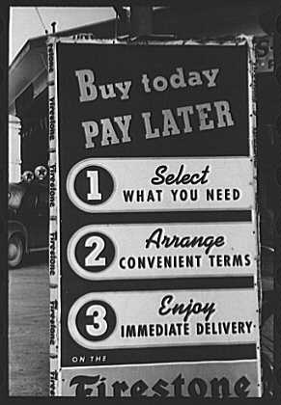
The 1920s was known as a prosperous time, but not for everyone
Installment buying, using credit and paying back in small amounts, was introduced which allowed people to buy cars, radios and other new products of the 1920s.
Farmers, however, were in a depression throughout the whole decade.

Slide 4
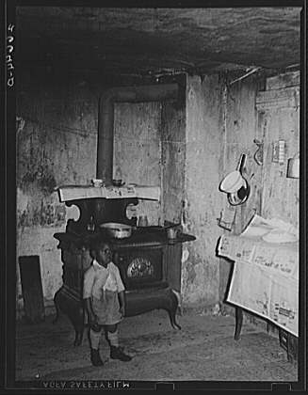
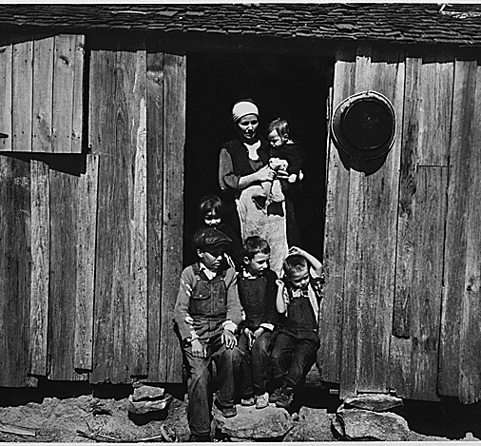
RURAL POVERTY IN THE 1920’S

Slide 5
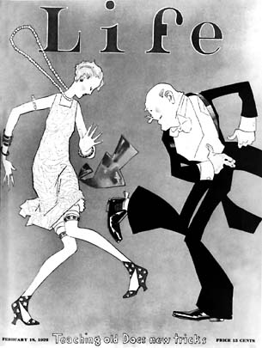

UNEQUAL DISTRIBUTION OF WEALTH
Although the nation's wealth grew by billions throughout the 1920s, it was not distributed evenly.
The top 1% received a 75% increase in their disposable income while the other 99% saw an average 9% increase in their disposable income.
80% of Americans had no savings at all.
Disposable income is money remaining after the necessities of life have been paid for.

Slide 6
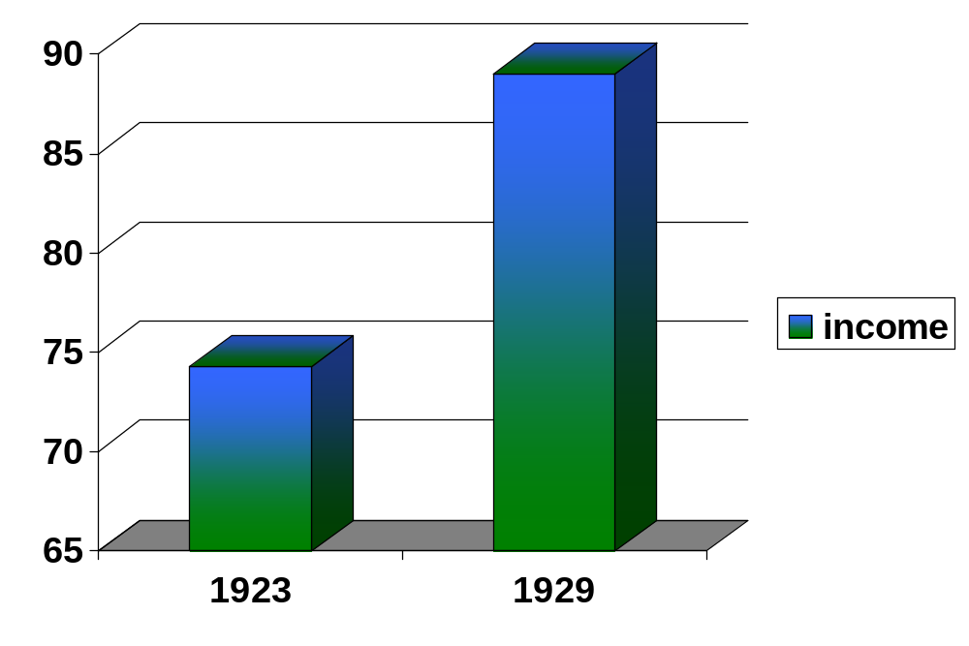
The economy grew by billions throughout the 1920s. Total realized income rose from $74.3 billion in 1923 to $89 billion in 1929

Slide 7
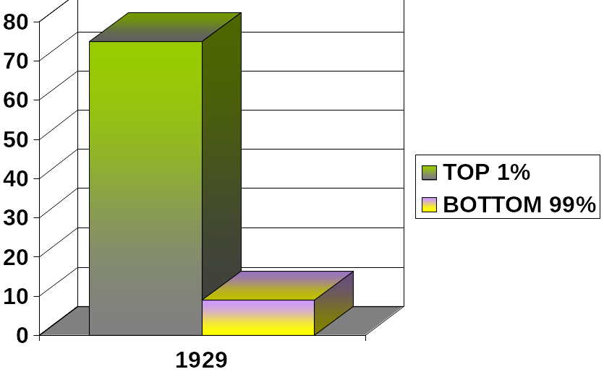
The chart shows that 99% of the population received a 9% increase in their income, while the top 1% saw their income rise by 75%.

Slide 8
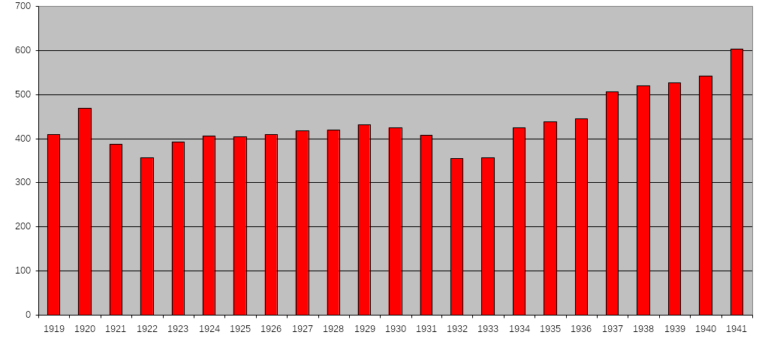
Chart showing wages of unskilled workers. Notice how little the wages changed during the supposed prosperity of the 1920’s.
Notes:
WHY DO THINK WAGES STARTED GOING UP BEGINNING IN 1938? (WAR SPENDING AROUND THE WORLD)

Slide 9
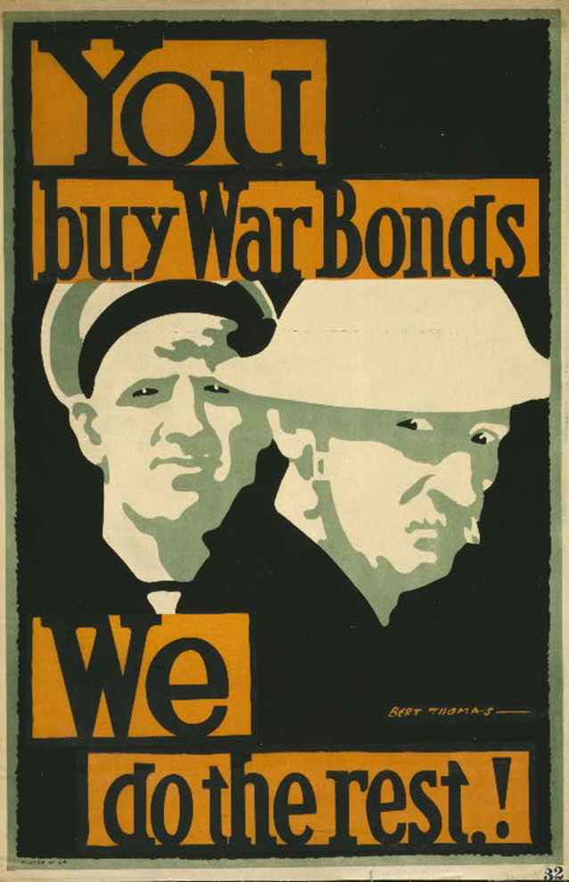
HIGH TARIFFS AND WAR DEBTS
At the end of World War I, European nations owed over $10 billion ($115 billion in 2002 dollars) to their former ally, the United States. Their economies had been devastated by war and they had no way of paying the money back.
The U.S. insisted their former allies pay the money. This forced the allies to demand Germany pay the reparations imposed on her as a result of the Treaty of Versailles. All of this later led to a financial crisis when Europe could not purchase goods from the U.S. This debt contributed to the Great Depression.
In 1922, the U.S. passed the Fordney-Mc Cumber Act, which instituted high tariffs on industrial products. A tariff is a tax on imports. Other nations soon retaliated and world trade declined helping bring on the great depression.

Slide 10
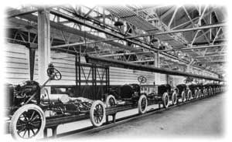
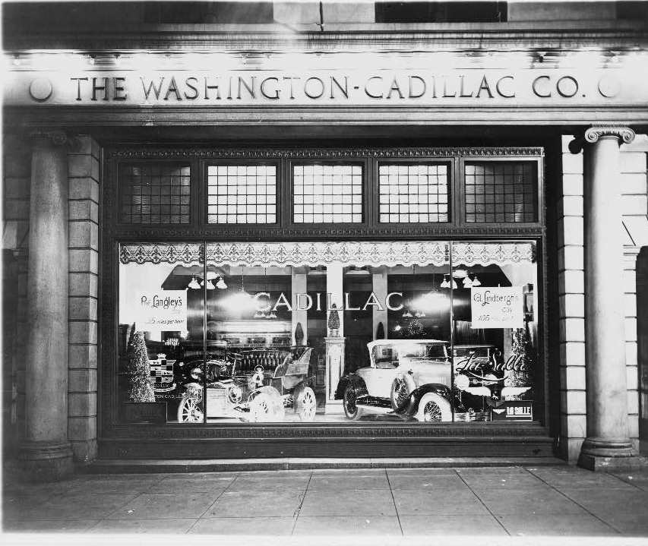
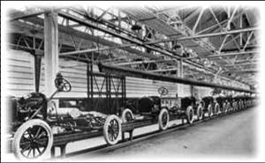
OVERPRODUCTION IN INDUSTRY
Factories were producing products, however wages for workers were not rising enough for them to buy them.
Too few workers could afford to buy the factory output.
The surplus products could not be sold overseas due to high tariffs and lack of money in Europe.

Slide 11
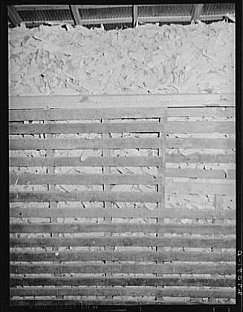
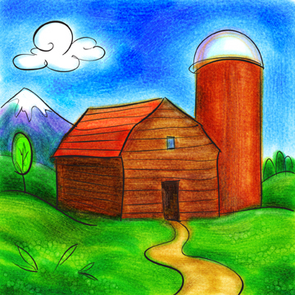
FARM OVERPRODUCTION
Due to surpluses and overproduction, farm incomes dropped throughout the 1920’s.
The price of farm land fell from $69 per acre in 1920 t0 $31 in 1930.
Agriculture was in a depression which began in 1920, lasting until the outbreak of World War II in 1939.
In 1929 the average annual income for an American family was $750, but for farm families it was only $273.
The problems in the agricultural sector had a large impact since 30% of Americans still lived on farms.
Surplus ears of corn

Slide 12
Table shows the sharp decline in the prices of various products from American farms
Agricultural product | 1912-1913 | 1932-1933
Corn (per bushel) | 0.56 | 0.20
Wheat (per bushel) | 0.88 | 0.41
Oats (per bushel) | 0.34 | 0.17
Butter (per lb) | 0.21 | 0.13
Butterfat (per lb) | 0.25 | 0.16
Wool (per lb) | 0.24 | 0.10
Hogs (per cwt) | 7.50 | 3.80
Milk (per cwt) | 1.79 | 0.90

Slide 13
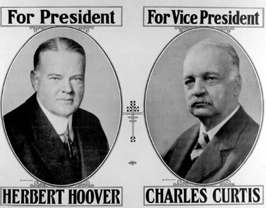
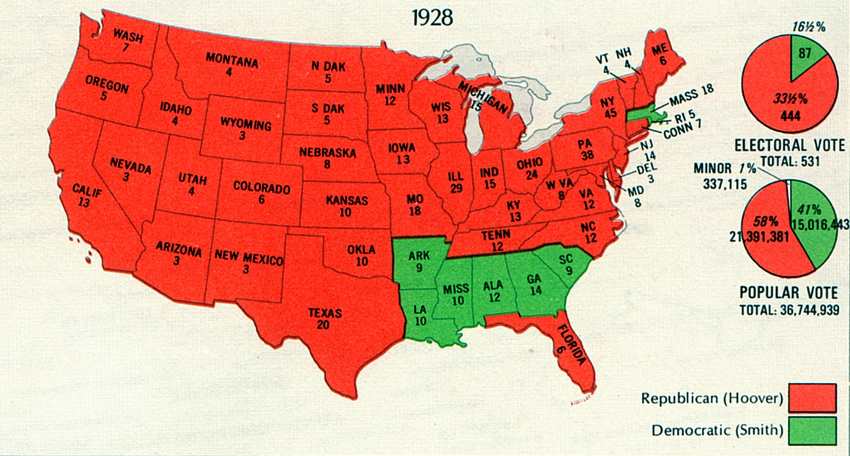
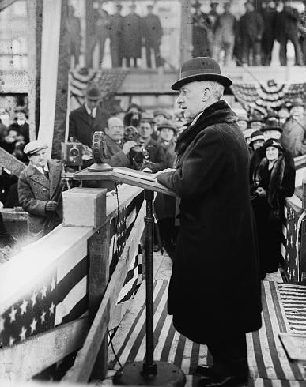
In the 1928 presidential contest, Democratic New York Governor Al Smith ran against Republican Secretary of Commerce Herbert Hoover. Many were suspicious of Smith who was Catholic, while Hoover was popular for feeding starving Europeans after WWI.
Al Smith

Slide 14
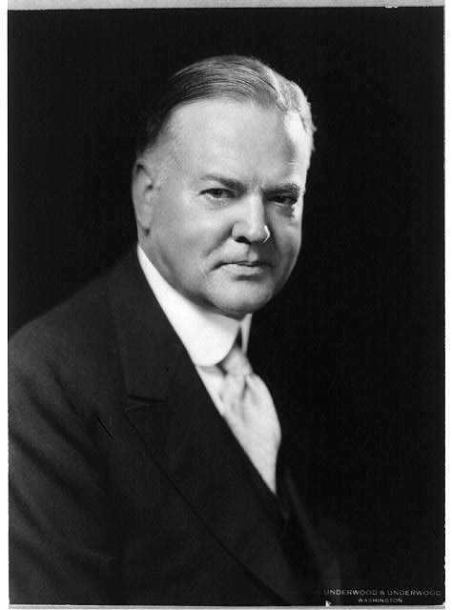
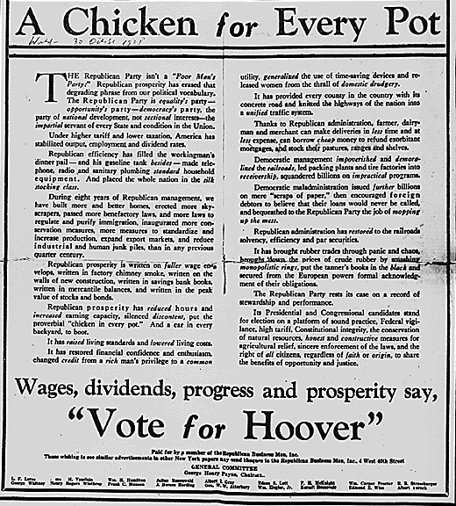


Hoover’s winning platform was based on continued prosperity
“We in America today are nearer to the final triumph over poverty than ever before in the history of any land. The poorhouse is vanishing from among us.” 1928
Hoover accepting the Republican nomination for president

Slide 15
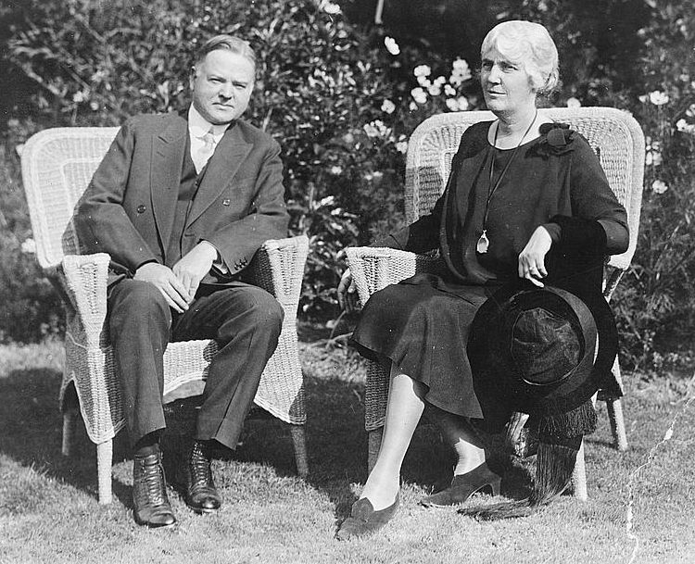
President Hoover’s belief in self-reliance would later affect his ideas about how to best solve the upcoming depression
"I do not believe that the power and duty of the General Government ought to be extended to the relief of individual suffering. . . . The lesson should be constantly enforced that though the people support the Government the Government should not support the people."
(1930)
President and Mrs. Hoover

Slide 16
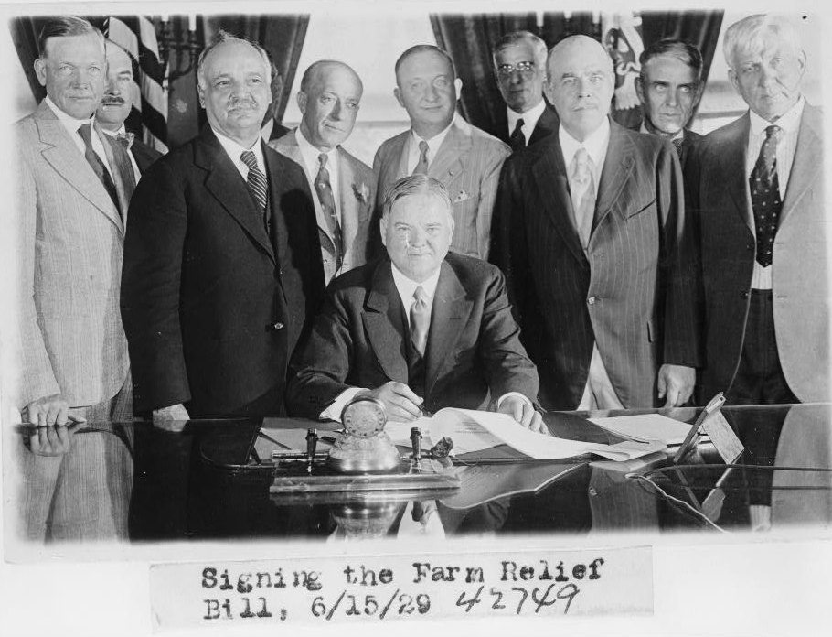
ONE OF HOOVER’S FIRST ACTS WAS DEALING WITH THE FARM CRISIS
Candidate Hoover: "The most urgent economic problem . . . is agriculture. It must be solved.
Notes:
MCNARY-HAUGEN BILL FEDERAL FARM BOARD, SUPPLIED WITH $500,000,000 TO ADVANCE TO FARM CO-OPERATIVES FOR MARKETING PURPOSES, TO STABILIZATION CORPORATIONS FOR BUYING AND HOLDING SURPLUS CROPS.

Slide 17
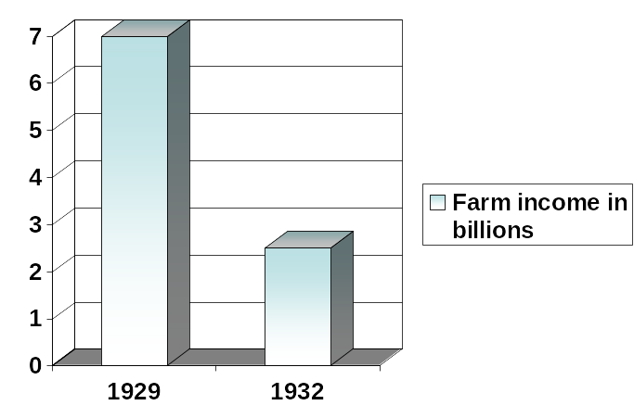
Farmers, who had been suffering during the 1920s, suffered further declines during the Great Depression. Wholesale food prices collapsed, which led to a lack of money to purchase new equipment and many could not pay for their mortgages and lost their farms.

Slide 18
U.S. Department of Agriculture’s yearbook from 1934 shows the unstable prices of foodstuff
YEAR | WHEAT | CORN | OATS | POTATOES | PEANUTS
1919 | 216.3 | 150.7 | 76.7 | 191.1 | 9.33
1920 | 182.6 | 61.0 | 53.8 | 133.2 | 5.26
1921 | 103.0 | 52.7 | 32.2 | 113.5 | 3.99
1922 | 96.6 | 75.2 | 37.4 | 68.6 | 4.68
1923 | 92.6 | 83.5 | 40.7 | 91.5 | 6.78
1924 | 124.7 | 105.3 | 47.8 | 71.5 | 5.68
1925 | 143.7 | 69.9 | 38.8 | 166.3 | 4.56
1926 | 121.7 | 75.3 | 40.1 | 136.3 | 4.97
1927 | 119.0 | 84.9 | 47.1 | 108.9 | 5.04
1928 | 99.8 | 84.3 | 40.7 | 57.2 | 4.90
1929 | 103.4 | 79.8 | 41.9 | 131.5 | 3.83
1930 | 67.0 | 59.4 | 32.2 | 91.5 | 3.54
1931 | 39.0 | 32.1 | 21.3 | 46.4 | 2.09
1932 | 37.9 | 31.8 | 15.7 | 38.8 | 1.53

Slide 19
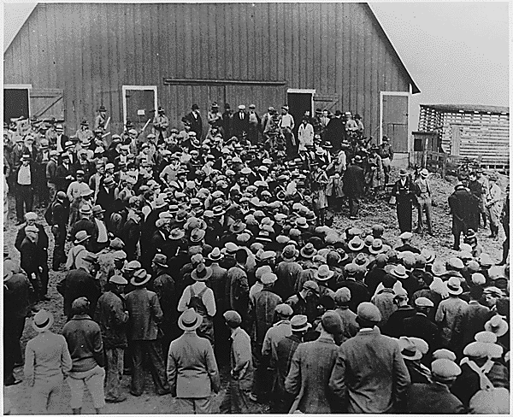
Pictured below is one of thousands of farm foreclosure sales. A foreclosure happens when an owner cannot pay for their mortgage and the bank repossesses the property to sell it.

Slide 20
Table shows the extreme drop in profits for farmers. This explains why they were unable to afford new equipment, and in many cases their mortgages, which led to the hundreds of thousands of foreclosures on farms.
 | 1910 | 1918 | 1932
Average gross receipts | 2177 | 3837 | 1512
Average expenditures | 770 | 1655 | 1019
Balance | 1407 | 2182 | 493

Slide 21
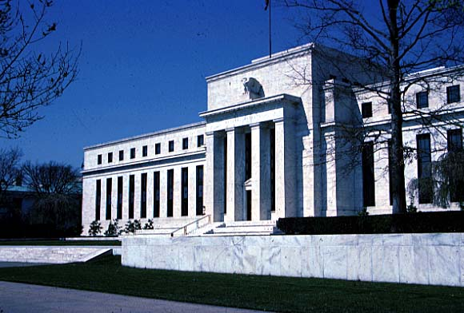

Federal Reserve Monetary Policy
The Federal Reserve System was created in 1913 to help stabilize the economy by establishing a central banking system for the U.S.
A major goal is to deal with bank panics.
Monetary policy manipulates the money supply to help strengthen the economy.
At the beginning of the Great Depression, the Fed did not address failing banks, and many scholars argue their idleness worsened the situation.

Slide 22
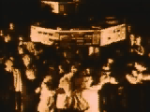
Millions of average Americans began speculating in the stock market in the 1920s. Speculating is buying risky stocks out of a desire to get rich quick, rather than investing because of a sound investment.

Slide 23
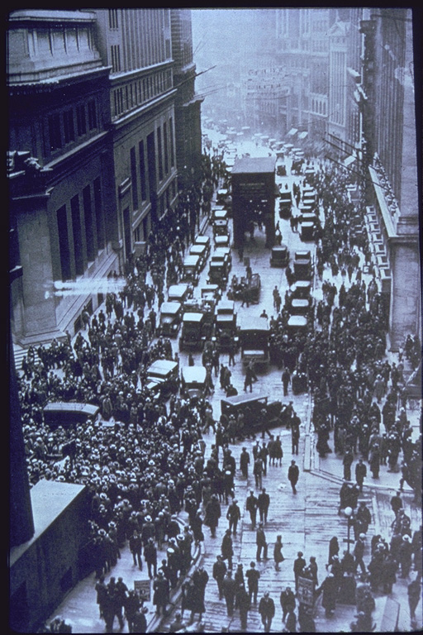
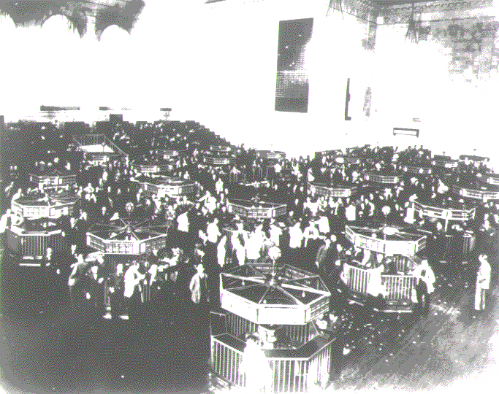
STOCK MARKET CRASH AND FINANCIAL PANIC
WALL STREET ON THE DAY OF THE CRASH, OCTOBER 1929
Notes:
The trading floor of the New York Stock Exchange just after the crash of 1929. On Black Tuesday, October twenty-ninth, the market collapsed. In a single day, sixteen million shares were traded--a record--and thirty billion dollars vanished into thin air. Westinghouse lost two thirds of its September value. DuPont dropped seventy points. The "Era of Get Rich Quick" was over. Jack Dempsey, America's first millionaire athlete, lost $3 million. Cynical New York hotel clerks asked incoming guests, "You want a room for sleeping or jumping?"

Slide 24
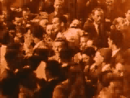
Major reasons for the stock market crash in October 1929
Stocks were overpriced due to speculation, meaning they were not worth their sale price
Massive fraud and illegal activity occurred due to a lack of regulation and rules
Margin buying, or buying using credit
Federal reserve policy

Slide 25

American Response to the Crash
In the immediate aftermath of the Crash, those who had savings in the banks, rushed en masse to withdraw their funds, fearful that they would be lost.
Faced with this frenzy of withdrawals, and unable to recover loans from bankrupt speculators, many banks were forced to close and declare bankruptcy. Consequently, many savers also lost their money.
Businesses began to fail and lay off workers as they were unable to obtain the necessary bank loans to tide them over. This led to higher unemployment and a deeper crisis.
Bank Failures | 1929 | 1930 | 1931
Number of banks closed. | 659 | 1,352 | 2294
Total deposits lost. | $200m | $853m | $1,700m

Slide 26
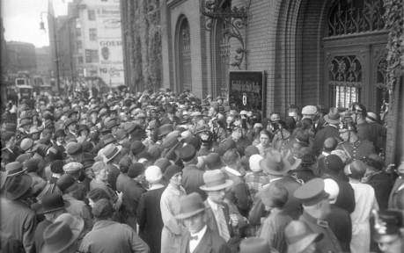


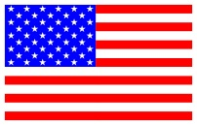
The Impact Abroad
The Crash immediately caused American investors to call in the funds they had lent to European nations like Germany to aid in their reconstruction.
This cause Germany to sink into Depression itself and made it impossible for them to continue to pay Reparations to England and France.
This, in turn, caused England and France to default on their war loan repayments to America. This caused further financial strain on the local economy and served to spread the Depression across the globe.
A German bank closes its doors.
Rebuilding loans
Reparations
War debts

Slide 27
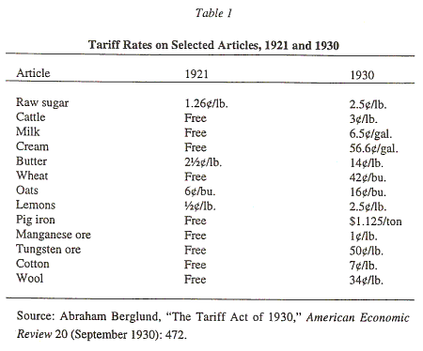
Smoot-Hawley Tariff Act
Introduced in 1930, this Act further increased the tariff levels on goods imported from overseas.
This lead to a harsh retaliatory response from America’s trading partners on goods being exported.
Consequently, the problem of over supply of local produce on the American market worsened as businesses could not sell their goods anywhere.

